Slide 1



ECE477 MIDTERM DESIGN REVIEW: TEAM #8

Slide 2
OUTLINE
Project Overview
Major Components
Block Diagram
Packaging Design
Electrical Schematic
PCB Layout
Prototyping Progress
Software Development Status
Project Timeline
Questions

Slide 3
PROJECT OVERVIEW
Description
The Smart Seating System is a solution designed to address occupancy management challenges in shared spaces by tracking seating availability in real-time.
It consists of three main components: Control Unit, Web Server, and Phone App.
Sensors collect data on seat occupancy and the Control Unit processes and transmits this data to the Web Server
Every seat in a space is equipped with a Control Unit
The Web Server intelligently analyzes data from all Control Units to determine seat occupancy in common spaces, providing visitors with real-time seating information through a user-friendly Phone App interface.
This system empowers users to make informed decisions about seating availability, enhancing the overall visitor experience, particularly during peak periods in public spaces.

Slide 4
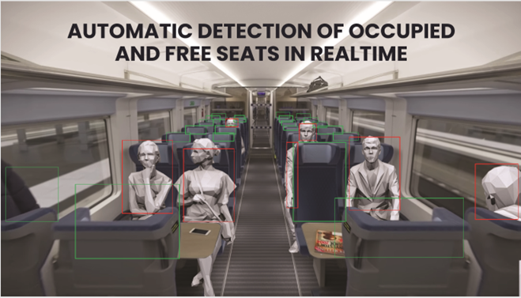
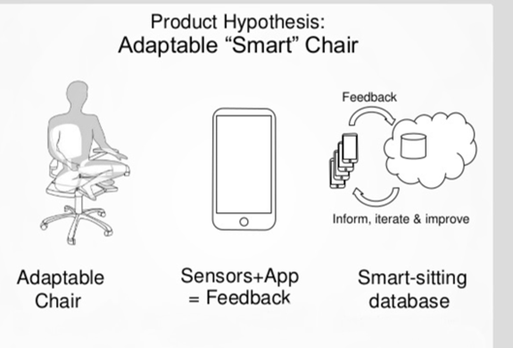
PROJECT OVERVIEW
Prior Art

Slide 5
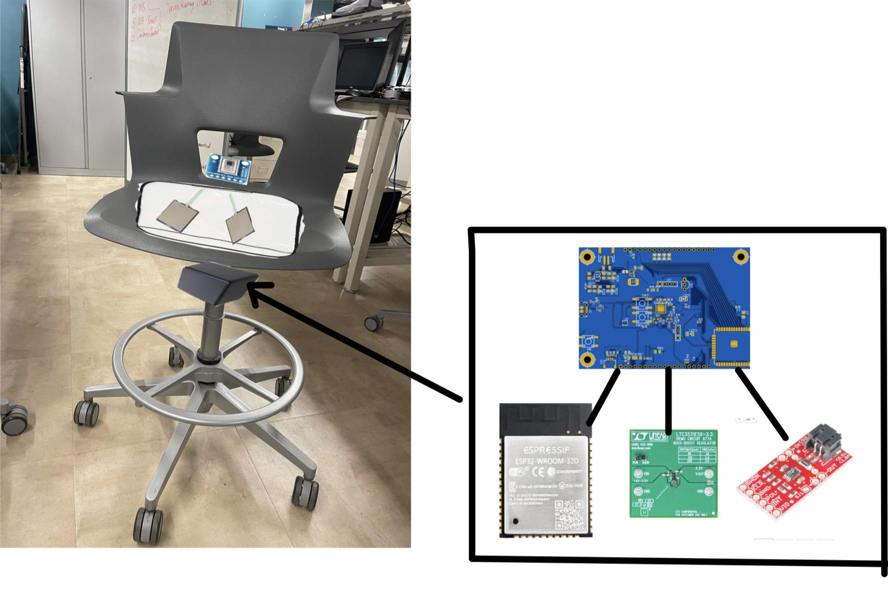
PROJECT OVERVIEW
Visual Representation

Slide 6
PSDRS
Up-To-Date PSDRs
PSDR #1 (Hardware): An ability to interface between a ESP32 micro and a Force Sensitive Resistor via ADC and voltage divider [Seat-Mounted]
PSDR #2 (Hardware): An ability to interface between a ESP32 micro and a Thermal Camera via I2C bus [Seat-Mounted]
PSDR #3 (Hardware): An ability to interface between a 3.7V li-ion battery power supply and micro/sensors via a 3.3V Buck-Boost Converter [Seat-Mounted]
PSDR #4 (Hardware): An ability to interface between a ESP32 micro and a Ultrasonic Distance Sensor via UART bus [Seat-Mounted]
PSDR #5 (Software): An ability for a computer to take in wirelessly transmitted sensor data and compute occupancy [Web-Server]
Stretch Goal #1 (Hardware): An ability to measure the power supply SOC via Interrupt with coulomb counting [Seat-Mounted]
Stretch Goal #2 (Software): An ability to display occupancy status of seats via a smartphone application [Front-End]

Slide 7
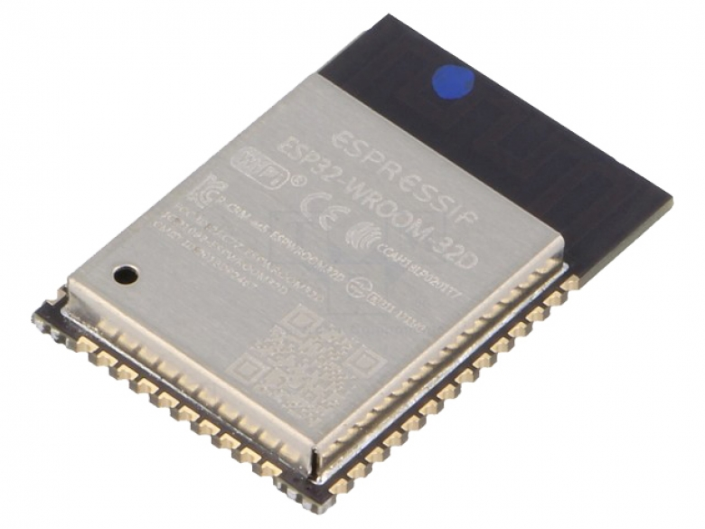
MAJOR COMPONENTS
MiCROCONTROLLER
ESP32-WROOM-32D
WIFI + Bluetooth MCU module
Adjustable CPU clock frequency 80MHz - 240MHz
Peripherals: SD Card, Ethernet, SPI, UART, I2C
Sleep Current < 5 µA
Operating Voltage: 3.0 - 3.6V
Operating Current: 80mA
Package Size: 18 mm × 25.5 mm × 3.10 mm

Slide 8
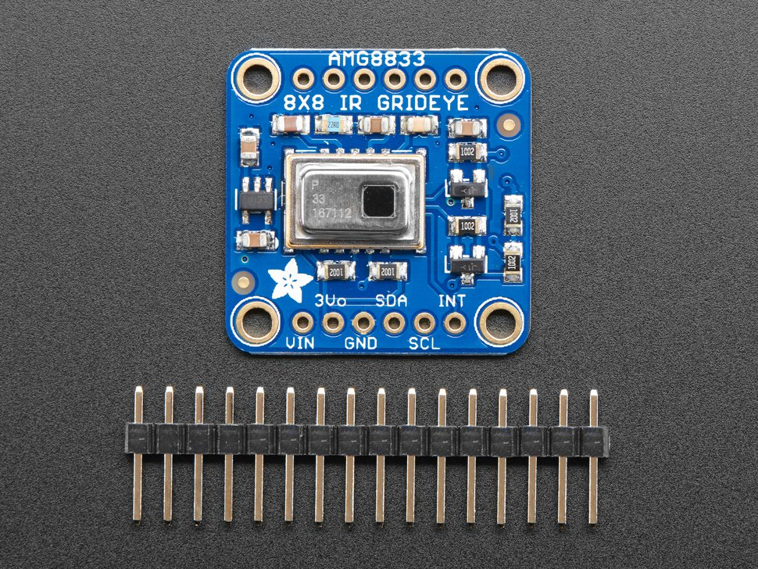
Major Components
AMG8833 Thermal Camera
AMG8833 Thermal Sensor
Construction: 8x8 array of IR thermal sensors
Returns an array of 64 individual infrared temperature readings over I2C protocol
Measures temperatures ranging from 0°C to 80°C (32°F to 176°F)
Operating Voltage: 3.3V

Slide 9
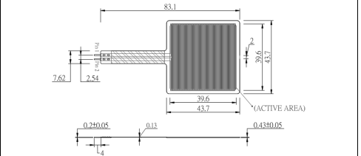
Major Components
Force Sensitive Resistor (FSR)
Alpha MF02A Force Sensitive Resistor
38mm square sensing region
Sensitivity range of 1 to 49N
Continuous analog reading

Slide 10
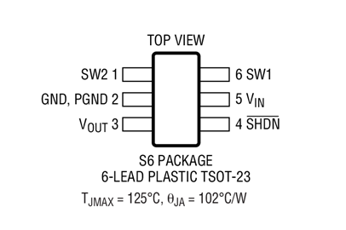
Major Components
LTC3531 Buck Boost
LTC3531 Buck Boost
Handle wide range of input voltages
VIN Range: 1.8V to 5.5V
200mA at 3.3VOUT from 3.6V Input
Adjustable VOUT Version (DFN): 2V to 5V
Up to 90% efficiency
Ultra Low Supply Current: 16μA, Shutdown Current <1μA

Slide 11
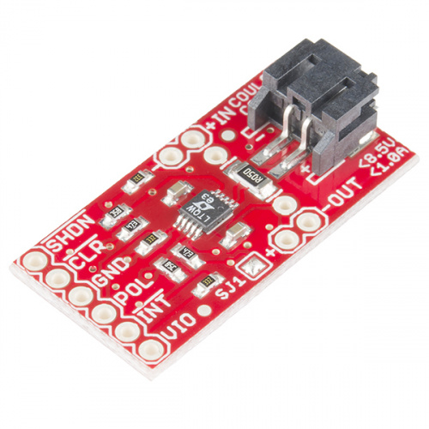
Major Components
LTC4150 Coulomb Counter
LTC4150 Coulomb Counter
Current monitor for battery
Accommodate power sources up to 8.5V, and currents up to 1A
Designed well for 3.7V Li-Po Batteries
±50mV Sense Voltage Range
High Side Sense
32.55Hz/V Charge Count Frequency
1.5μA Shutdown Current

Slide 12
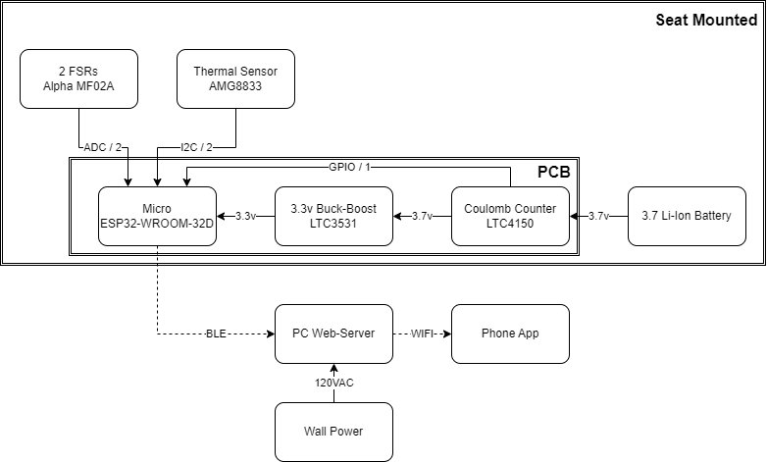
BLOCK DIAGRAM
Overall System Diagram

Slide 13
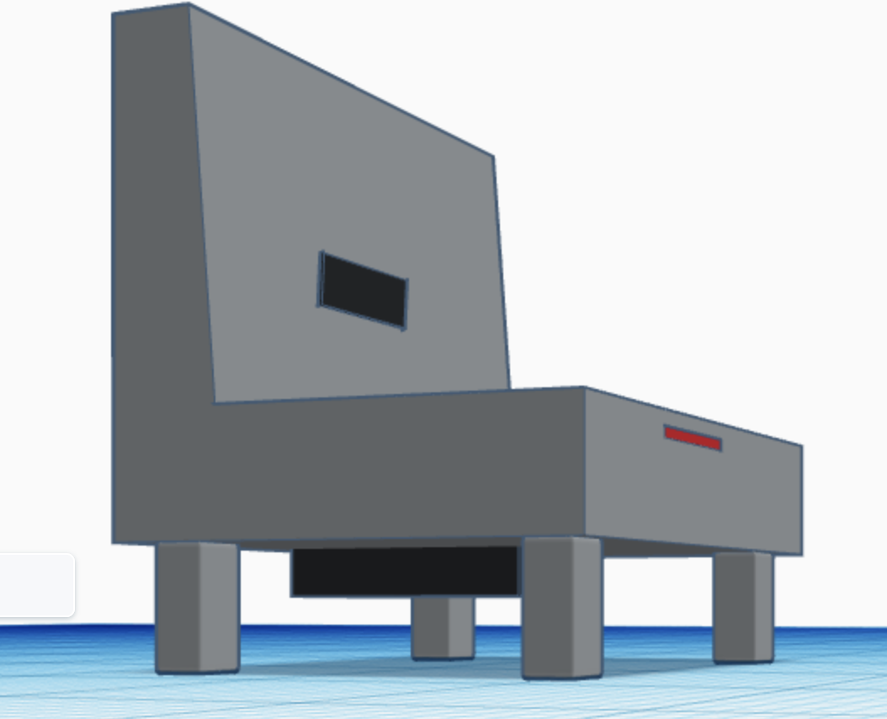
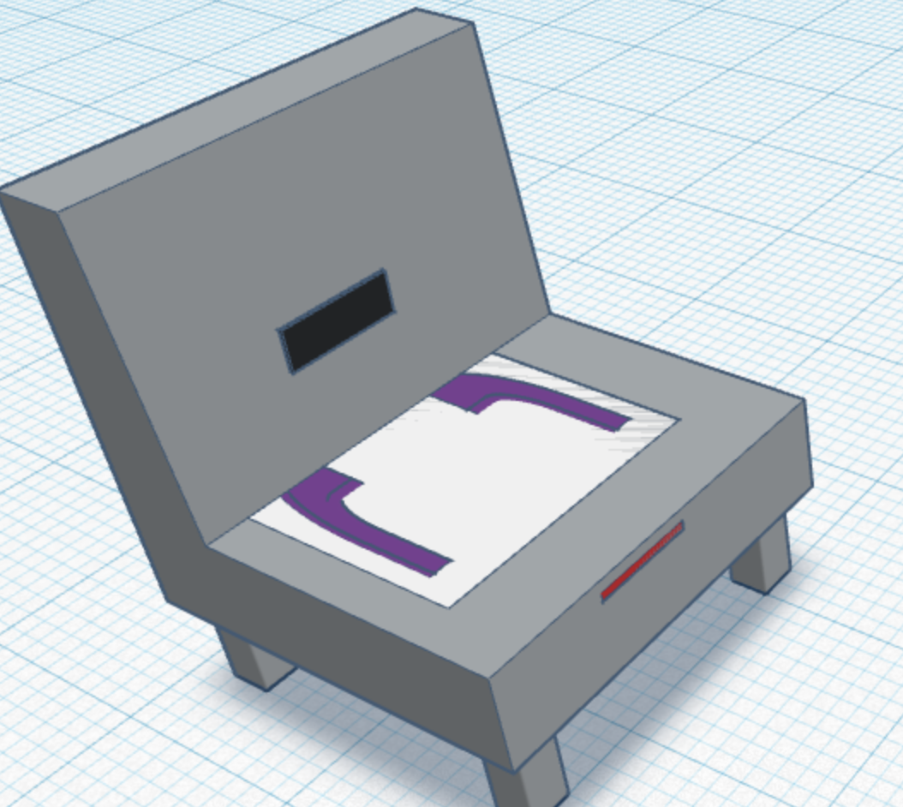
PACKAGING DESIGN
Seat Packaging
Dimension of FSR Pad: 16 x 12 x 1
Dimension of seat mounted box: 4 x 4 x 3

Slide 14
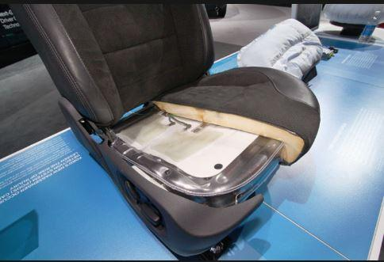
Packaging Design
Manufacturing Details
FSR Pad
Seat Mounted Box
Can be addressed in many ways:
Add a pad consisting of rubber and cushion material (with the FSR inside).
Create a large rubber type band that contains the FSRs laminated into it
Local hardware /furnishing stores can provide quick solutions for this
Can be addressed in different ways as well:
3D print a casing
Construct our own plastic case via materials from the hardware store
Mounting: drill points/holes, velcro, suction/vacuum,

Slide 15
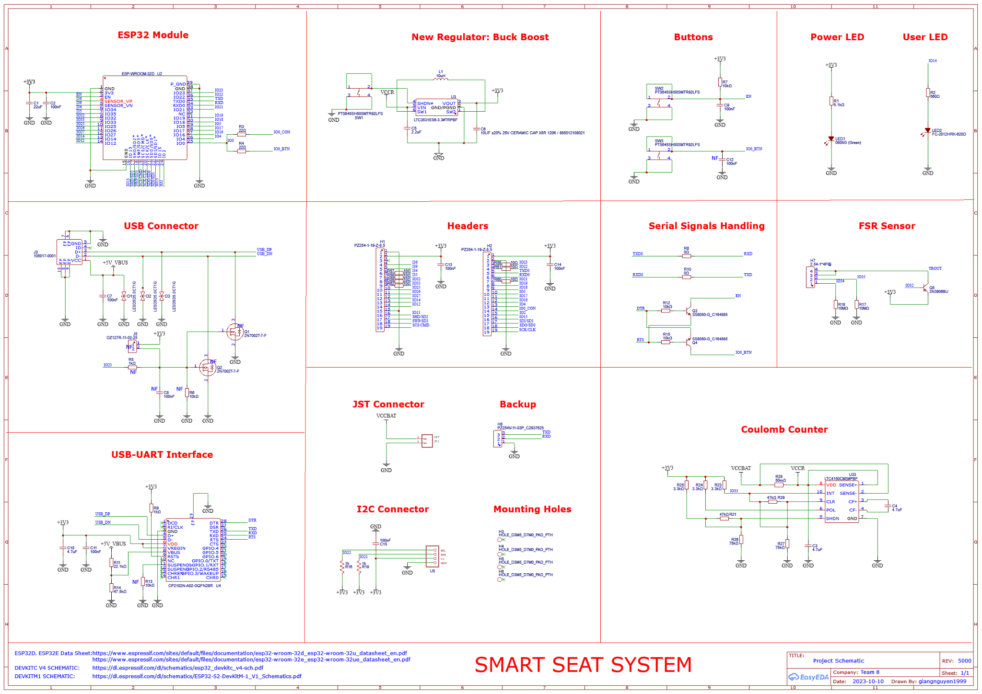
ELECTRICAL SCHEMATIC
Overall Schematic

Slide 16
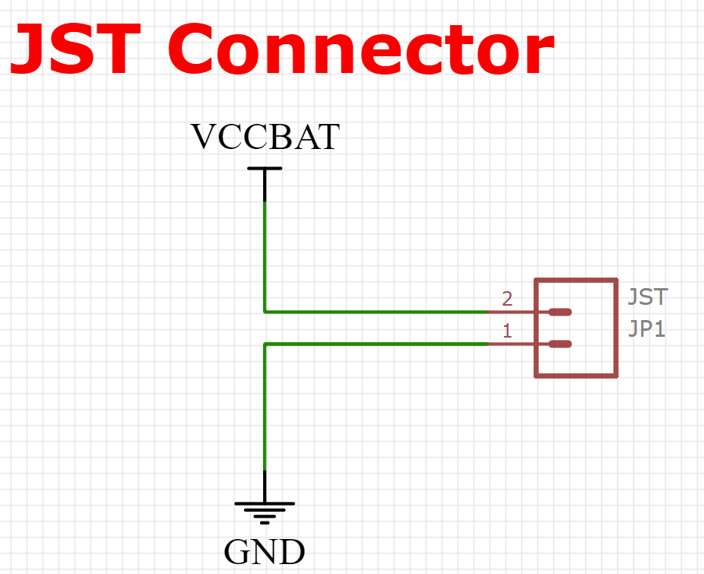
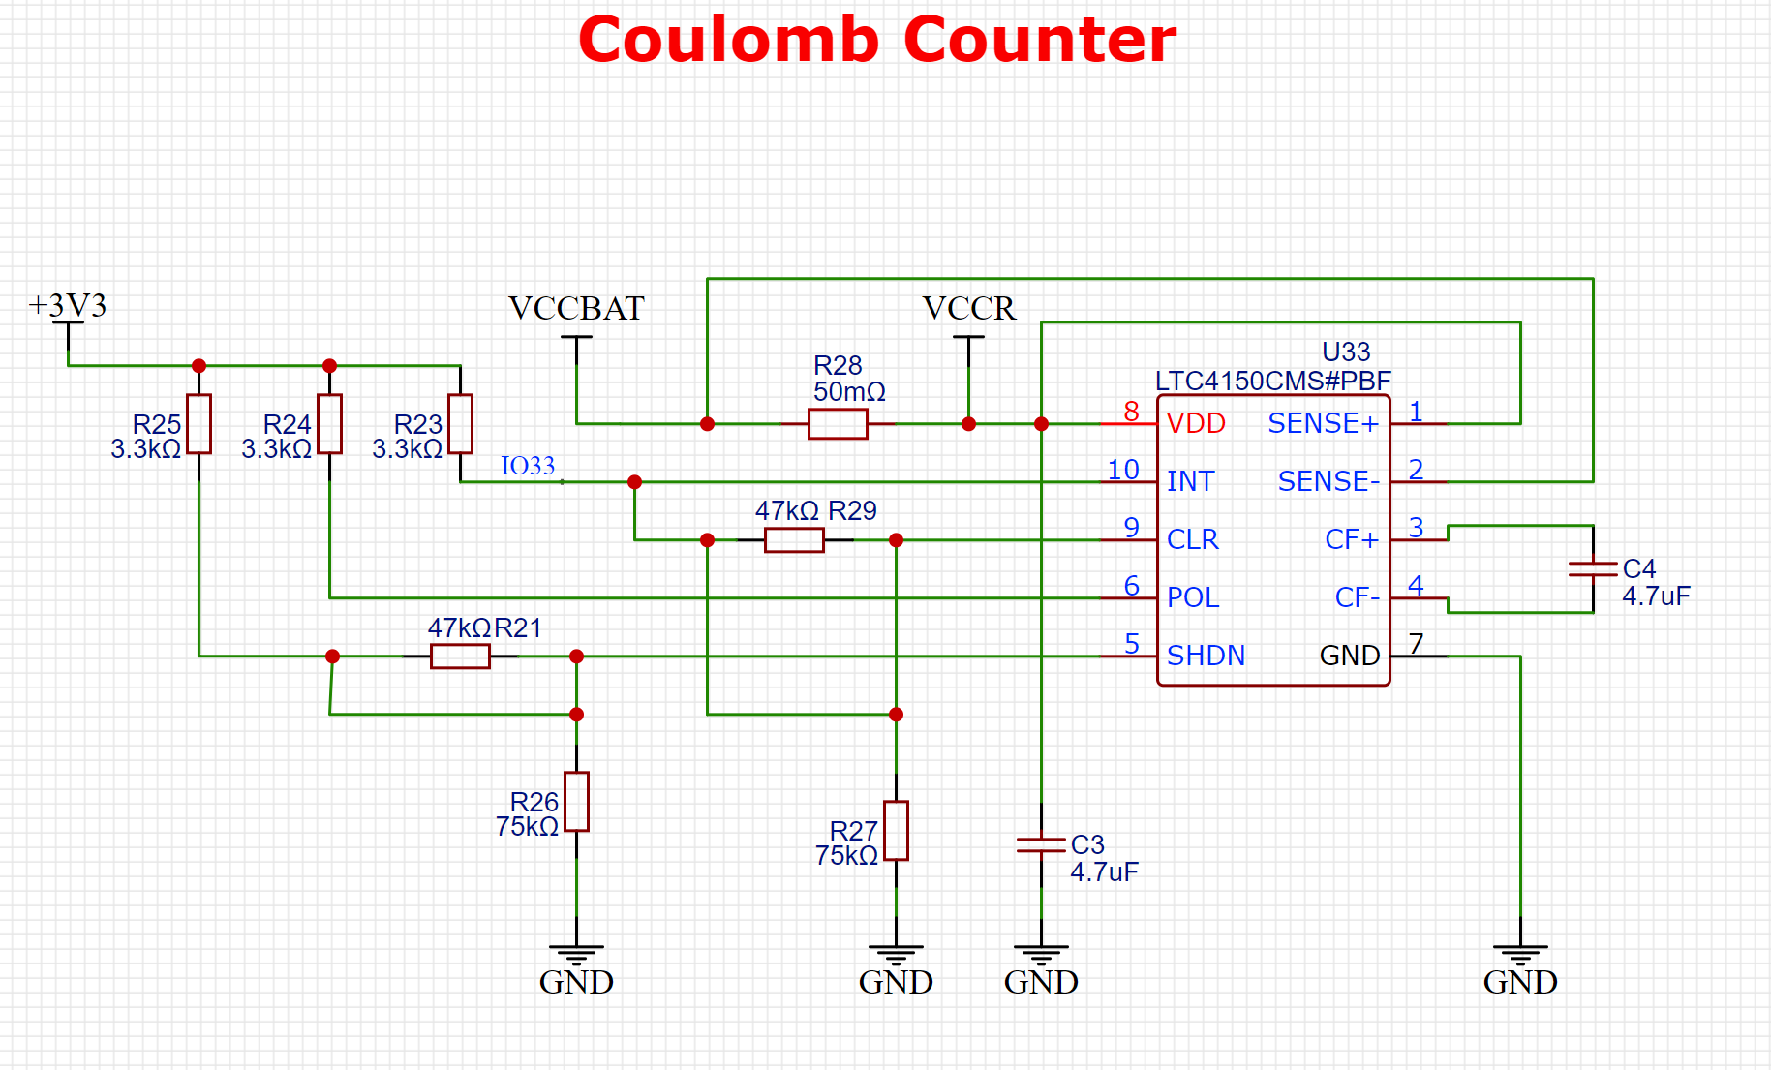
ELECTRICAL SCHEMATIC
Coulomb Counter

Slide 17
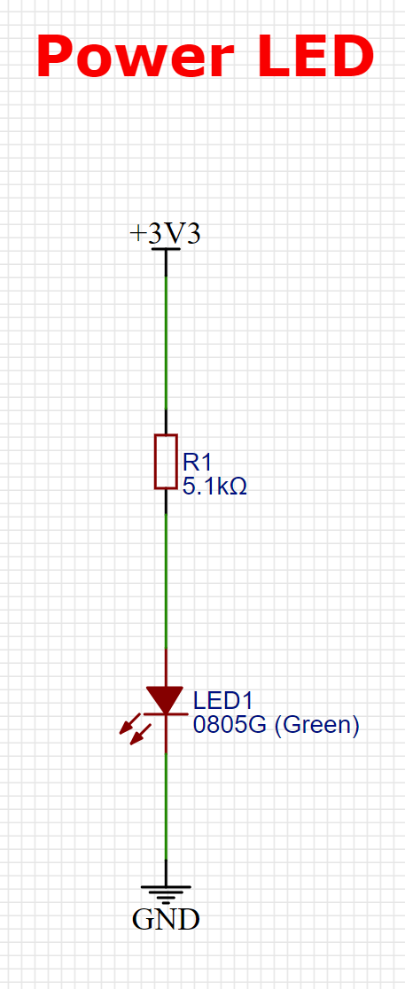
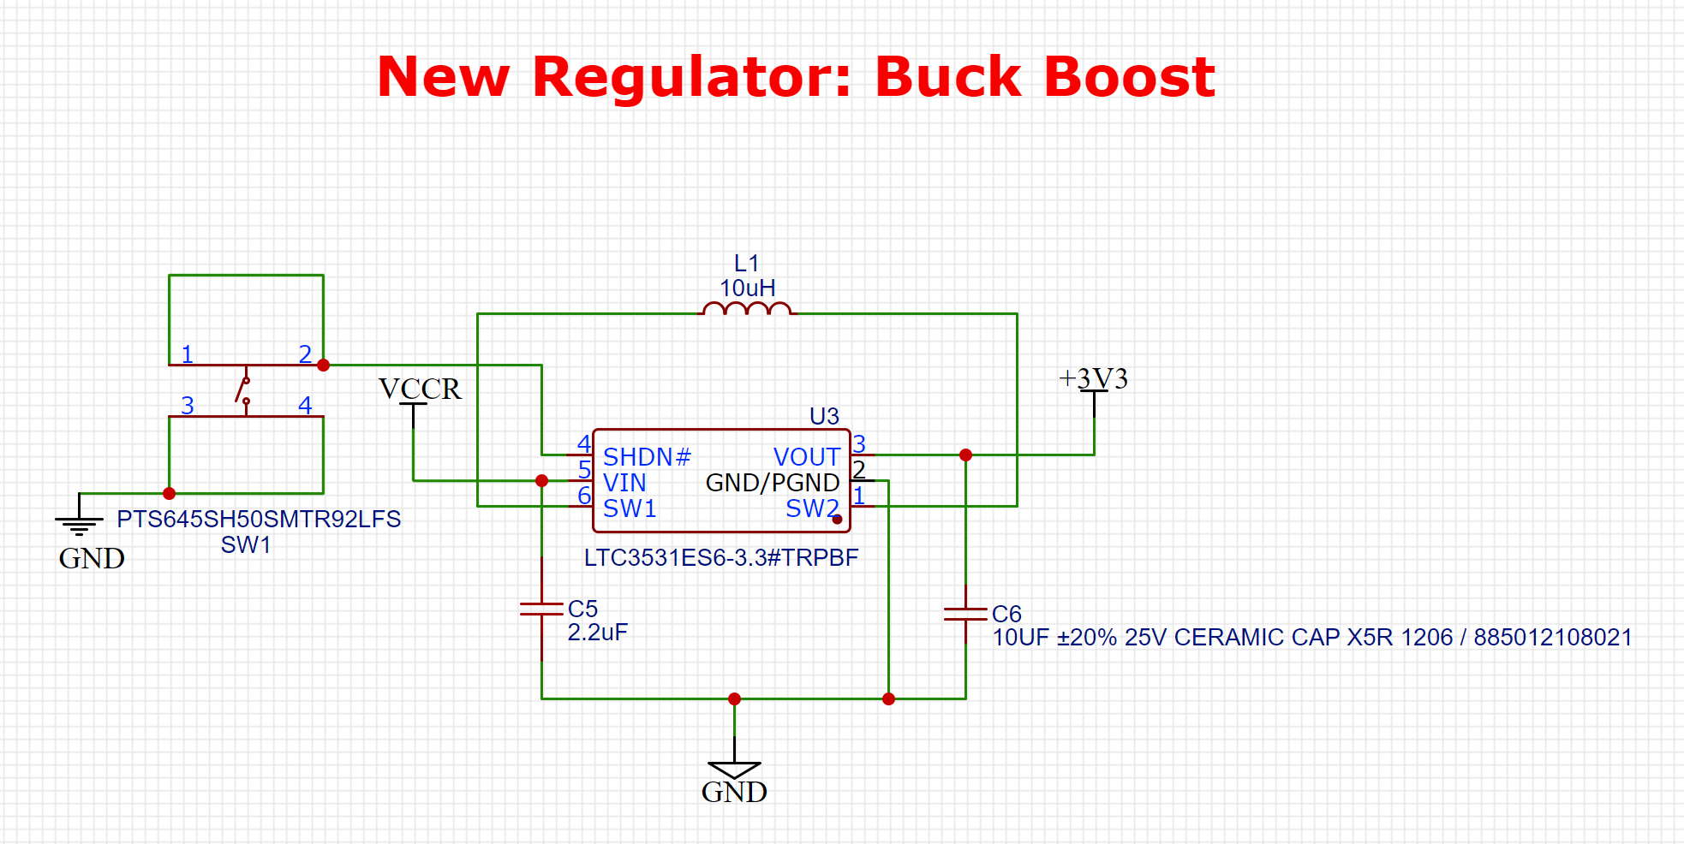
ELECTRICAL SCHEMATIC
Buck-Boost Regulator

Slide 18
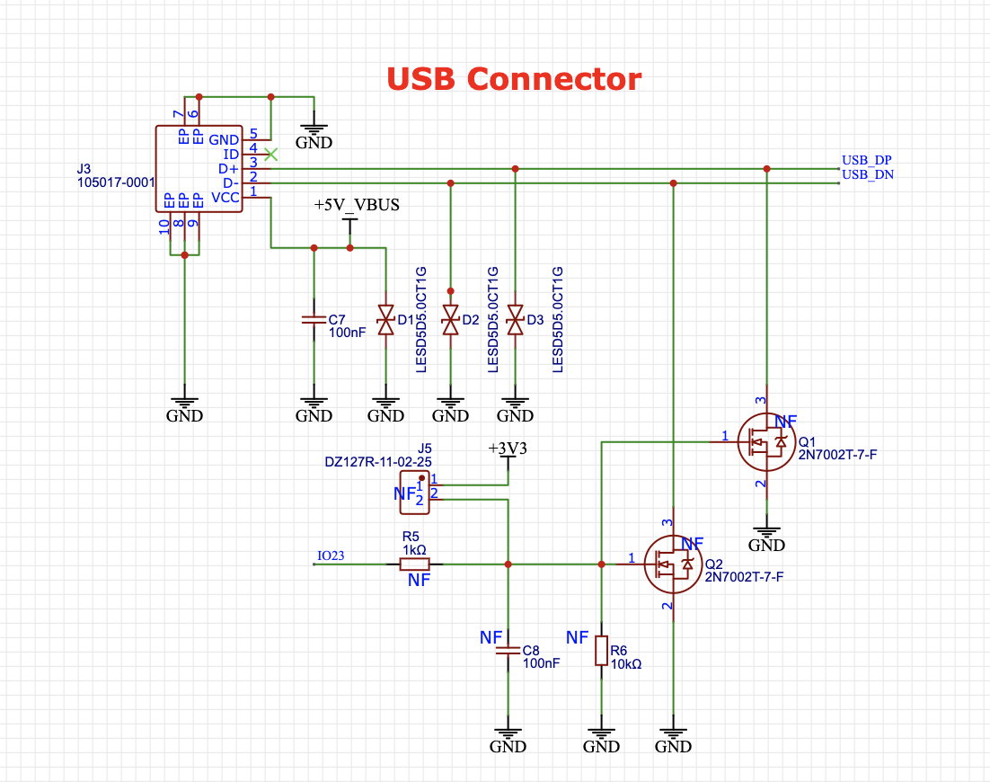
ELECTRICAL SCHEMATIC
USB Connector

Slide 19
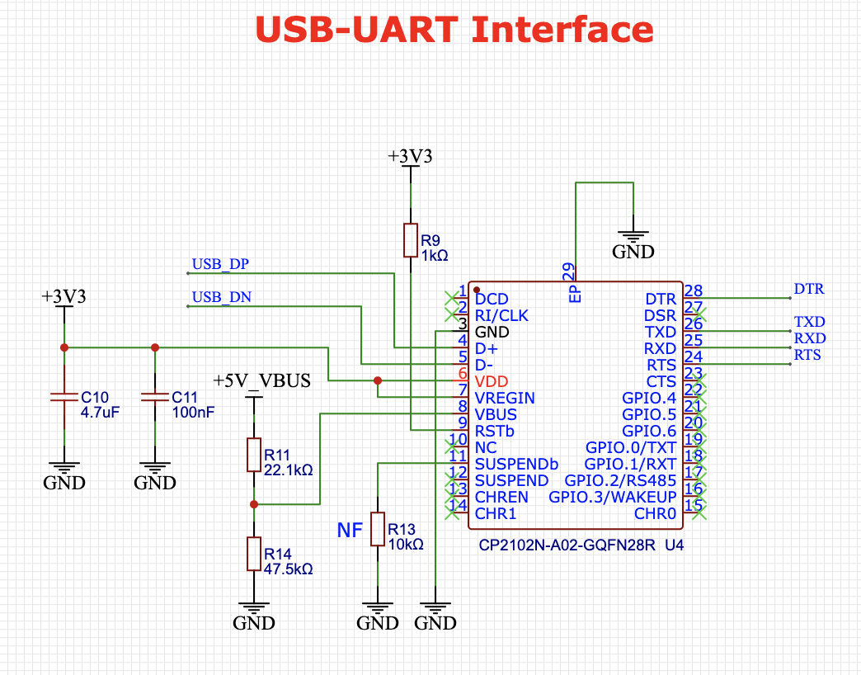
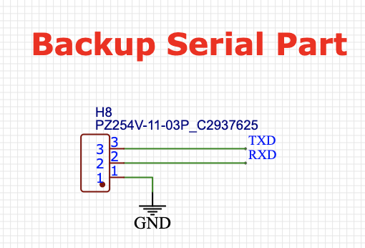
ELECTRICAL SCHEMATIC
USB TO UART CONNECTION

Slide 20
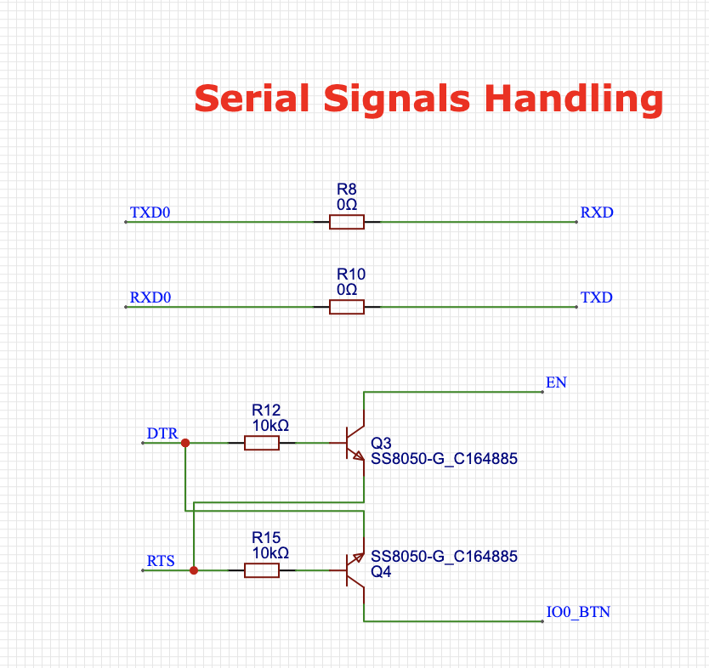
ELECTRICAL SCHEMATIC
SERIAL SIGNALS HANDLING

Slide 21
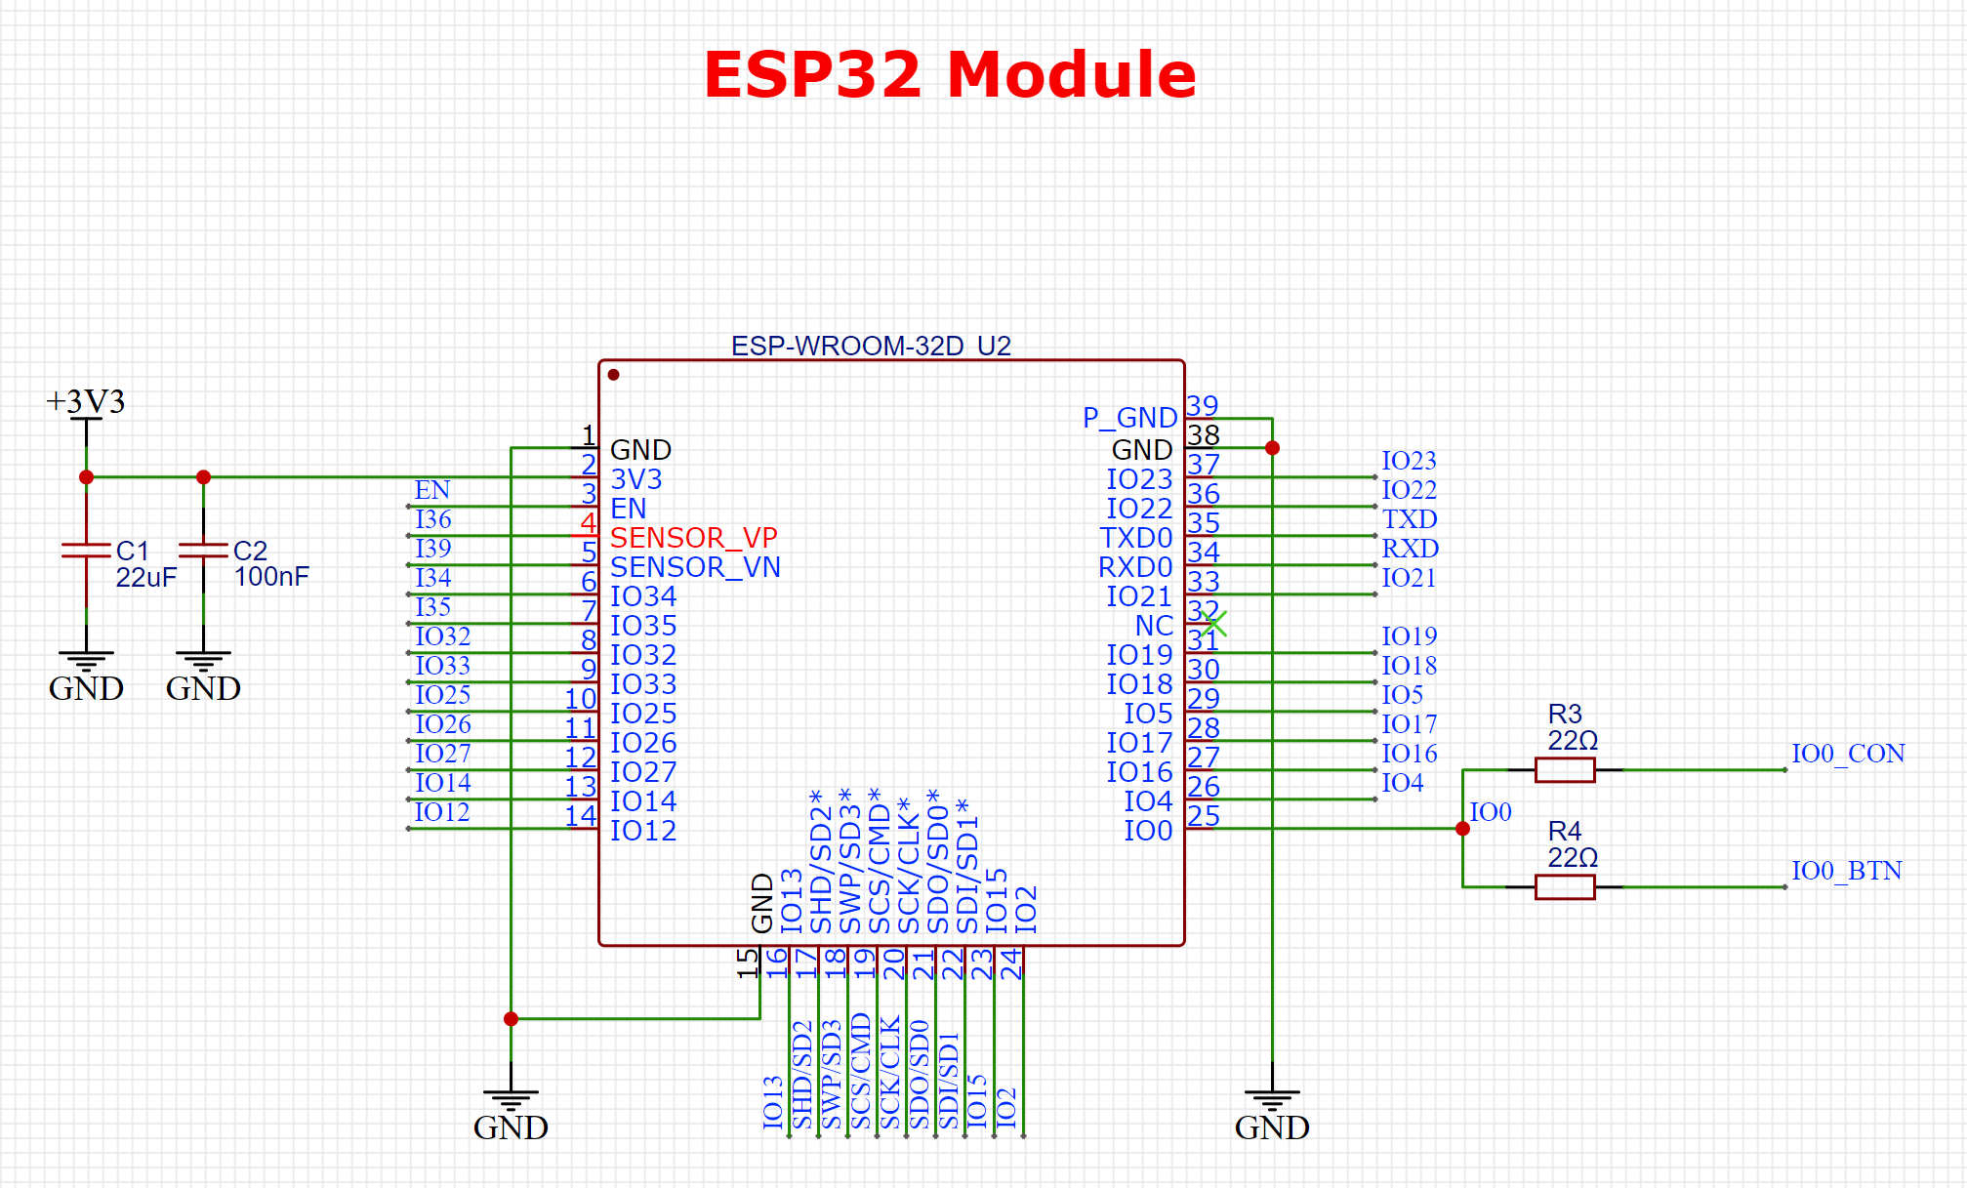
ELECTRICAL SCHEMATIC
ESP32

Slide 22
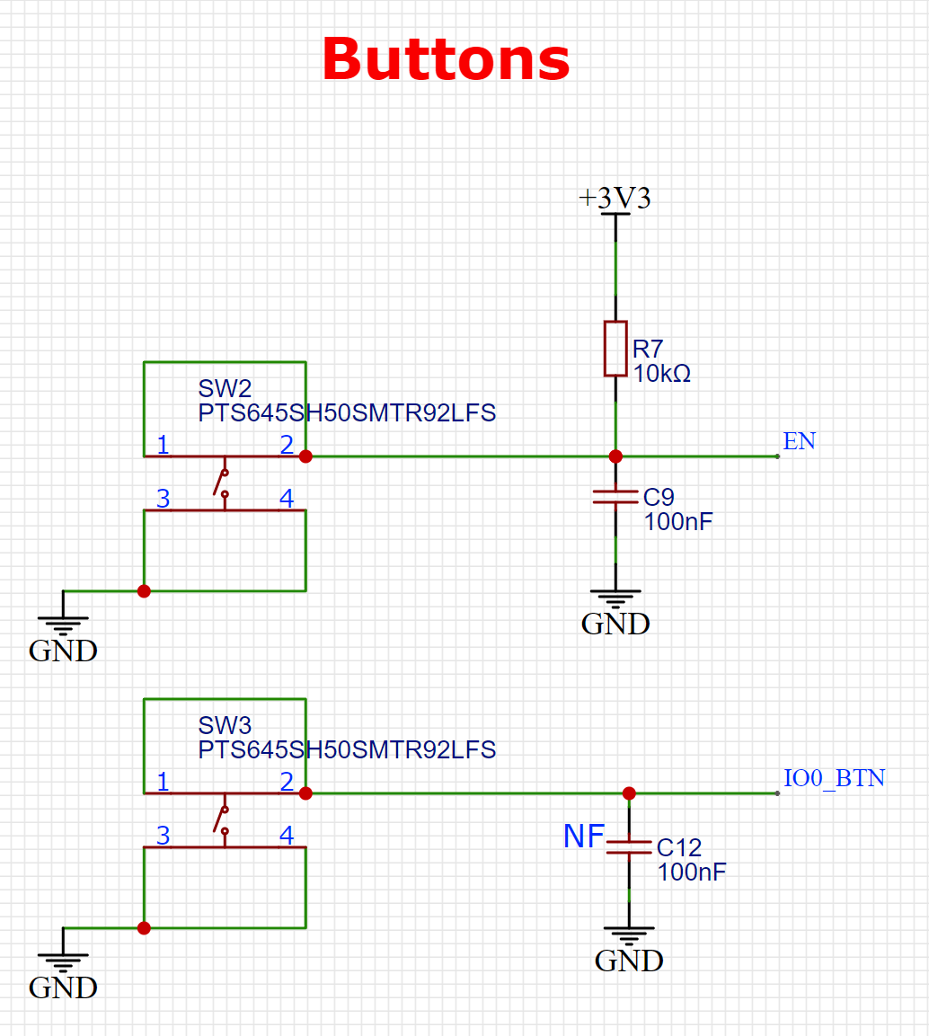
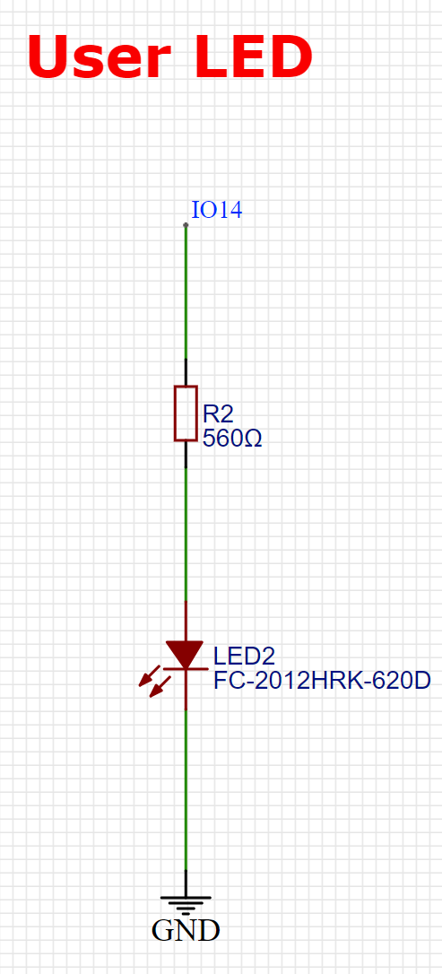
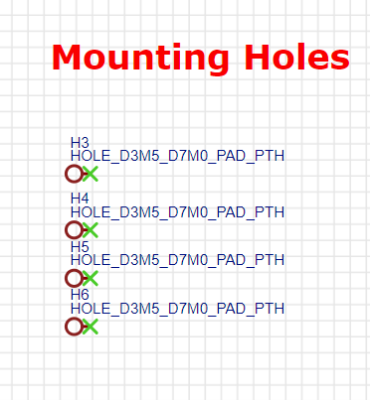
ELECTRICAL SCHEMATIC
ESP32 Accessories

Slide 23
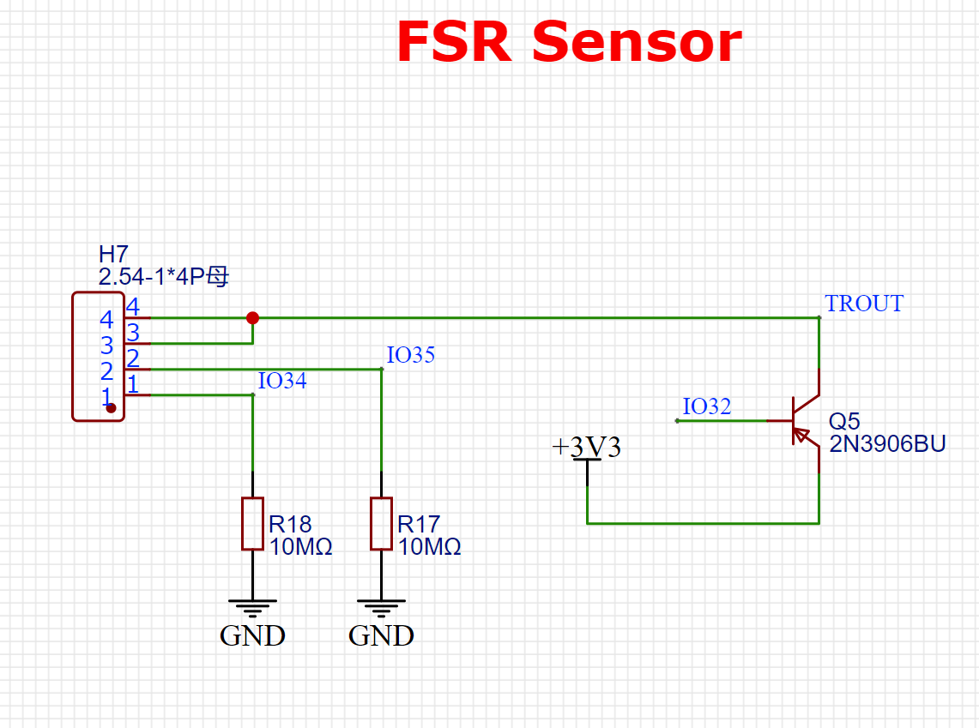
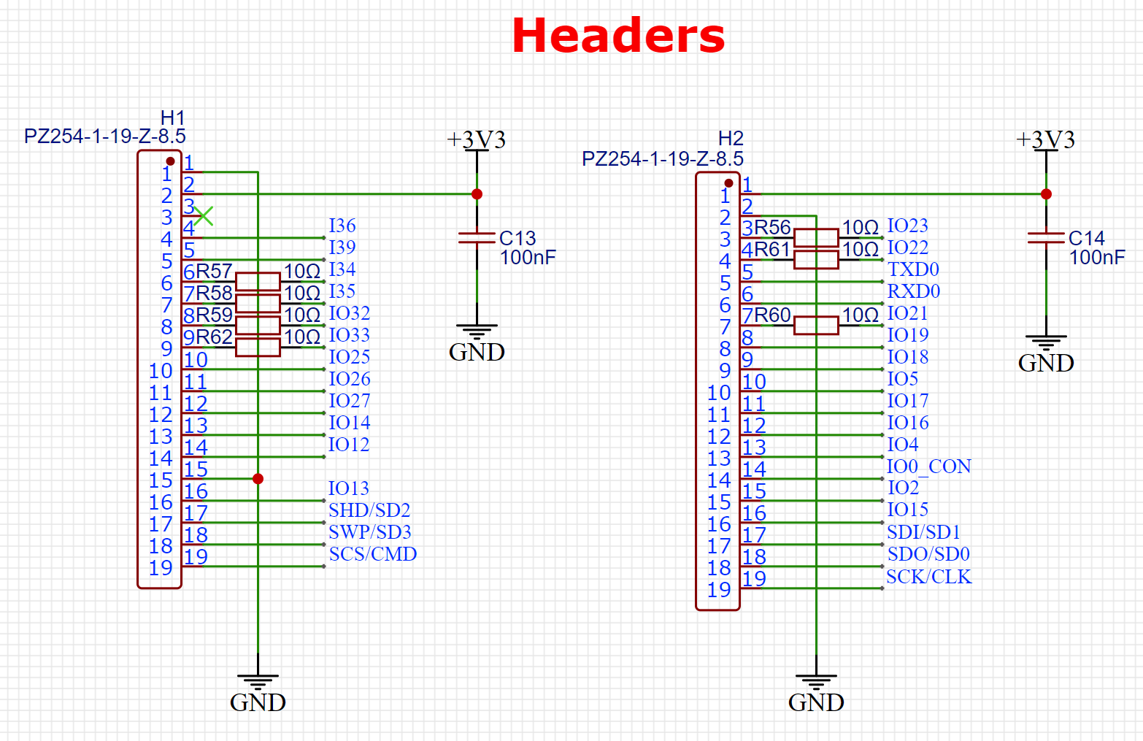
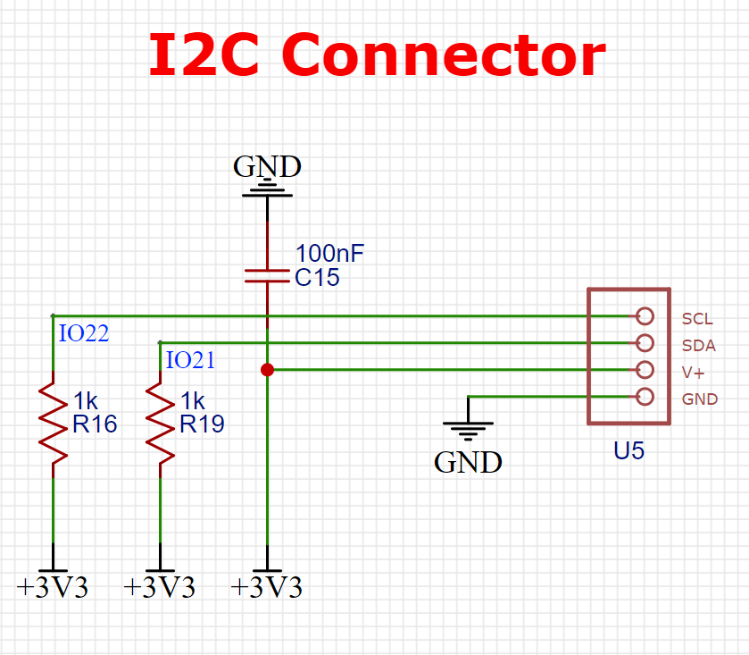
ELECTRICAL SCHEMATIC
External Connectors

Slide 24
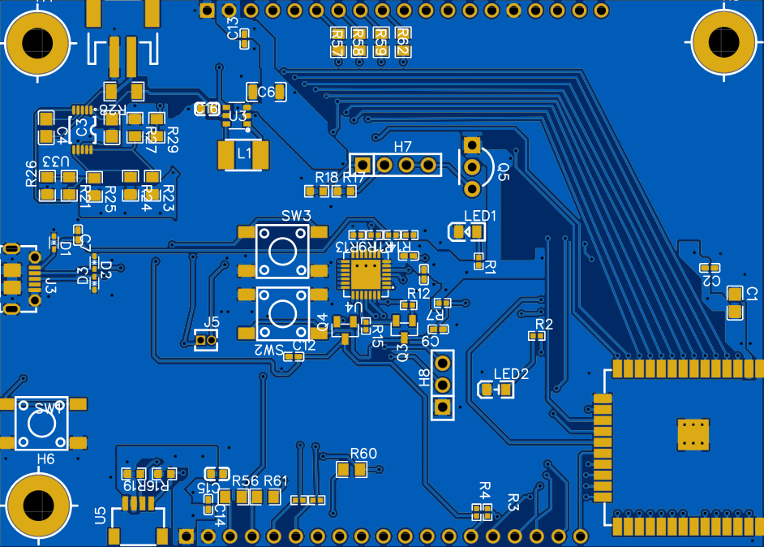
OVERALL LAYOUT
63.754 x 88.9 (mm)

Slide 25
PCB LAYOUT
Rule and Specifications
Single-sided board
0805 & 0603 & 1206 packages for Capacitor & Resistor
Design Rule:
Track width for 3V, 5V & GND: 8 mil
Track width for USB: 6 mil
Track width for Shunt Resistor: 12 mil
Clearance overall: 6 mil
Clearance USB: 8 mil
Via diameter: 20 mil & 24 mil

Slide 26
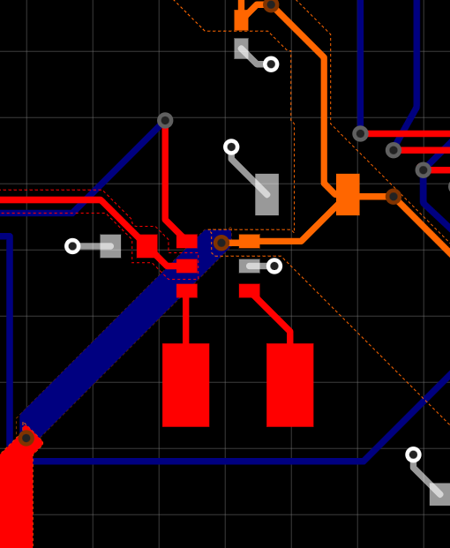
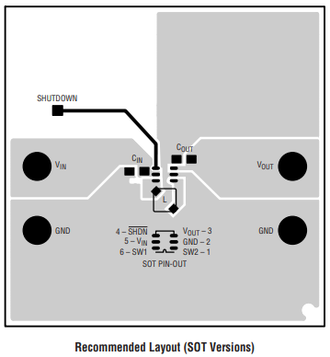
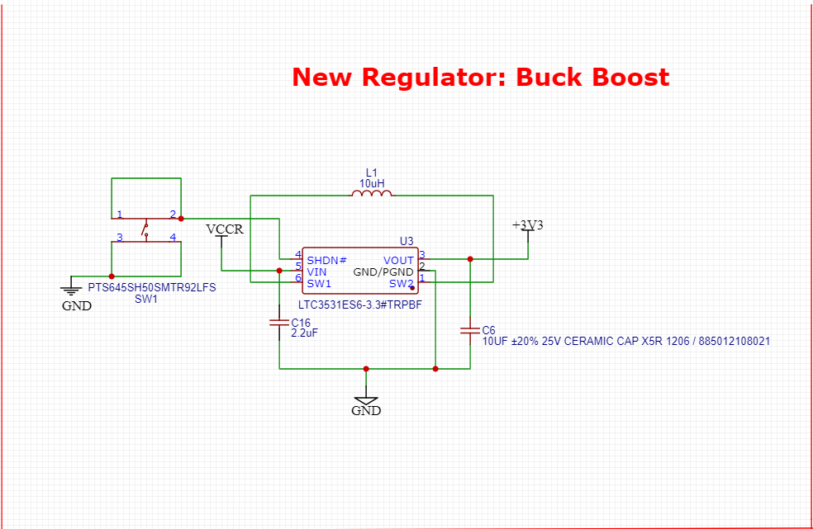
Power
BUCK BOOST CONVERTER 3.7V to 3.3V

Slide 27
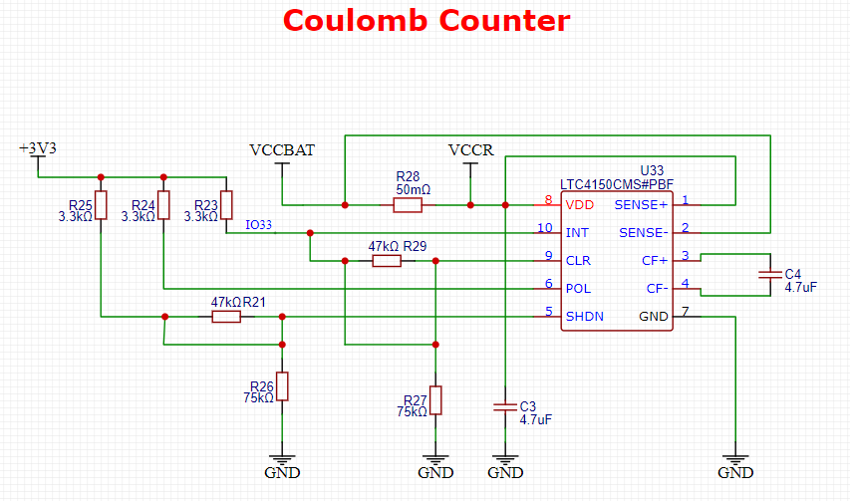
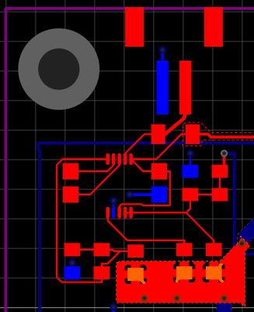
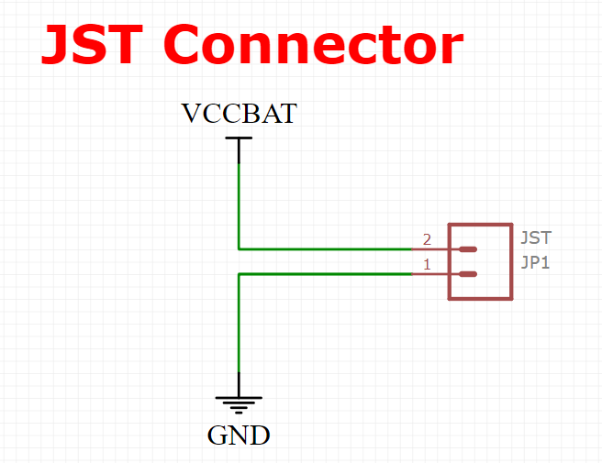
Power
Coulomb Counter

Slide 28
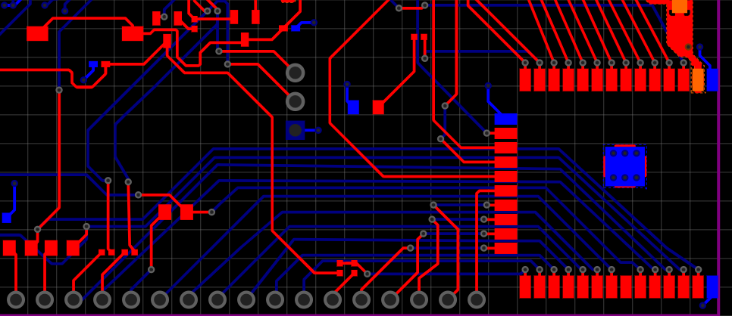
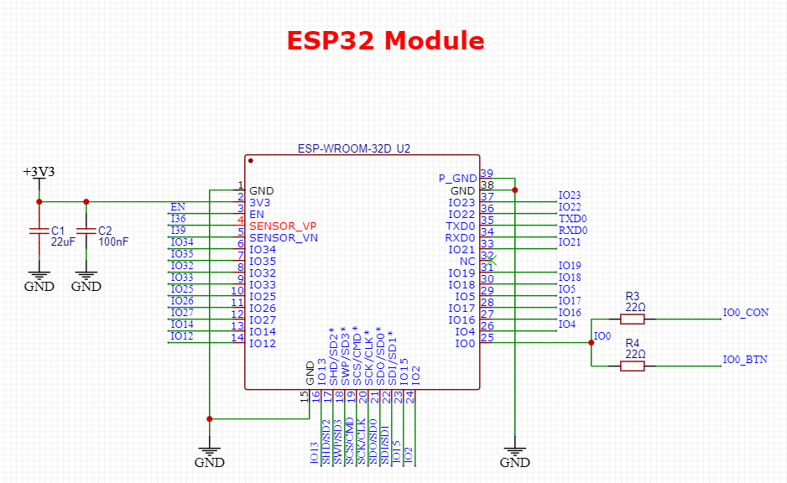
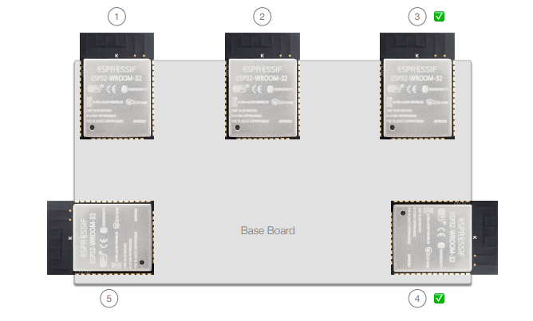
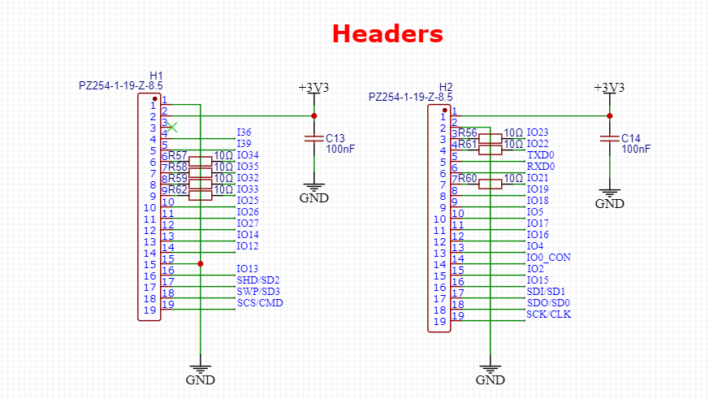
MCU
ESP32 & DEBUGGING HEADERS

Slide 29
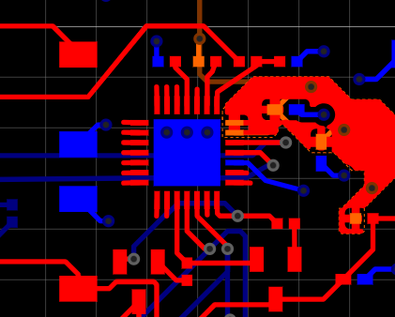
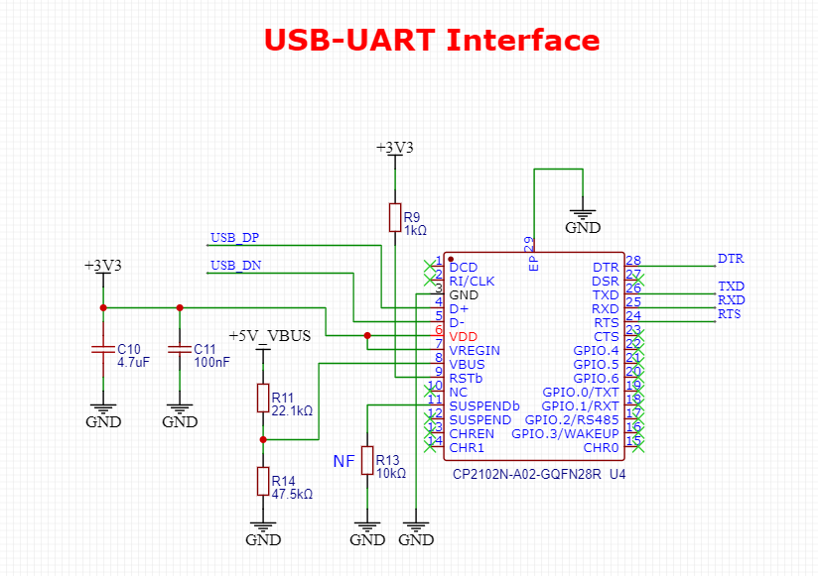
USB
USB to Serial

Slide 30
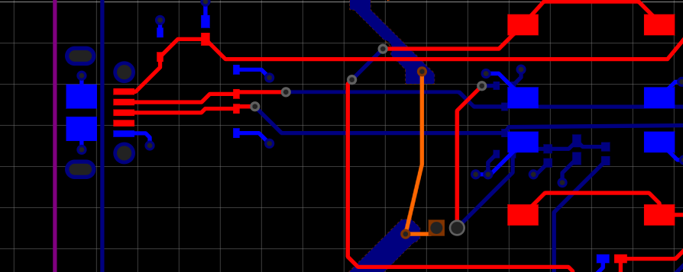
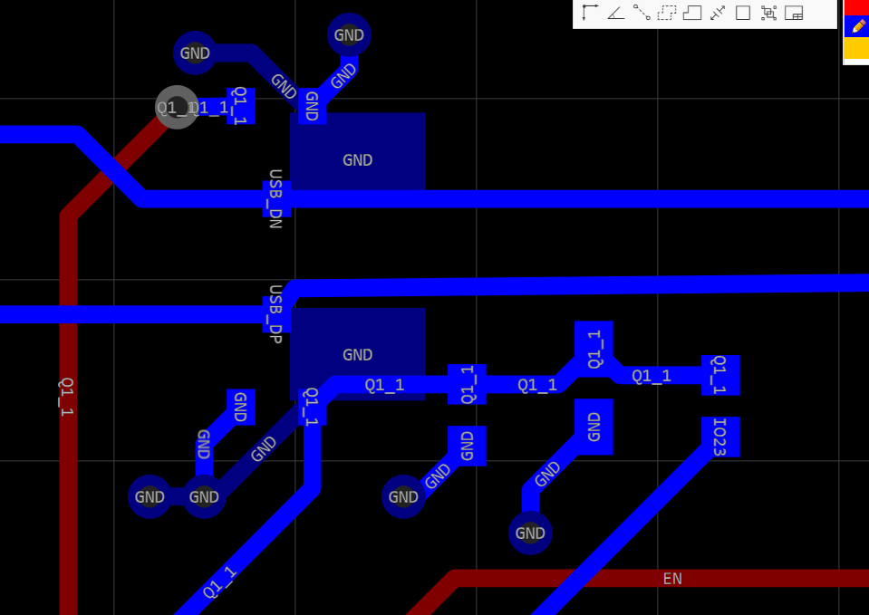
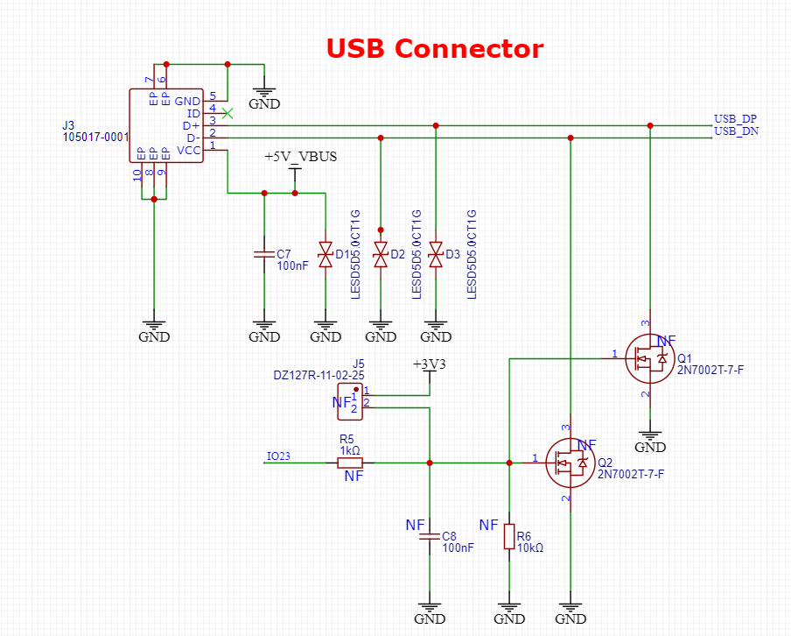
USB
USB Connector

Slide 31
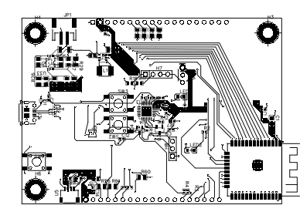
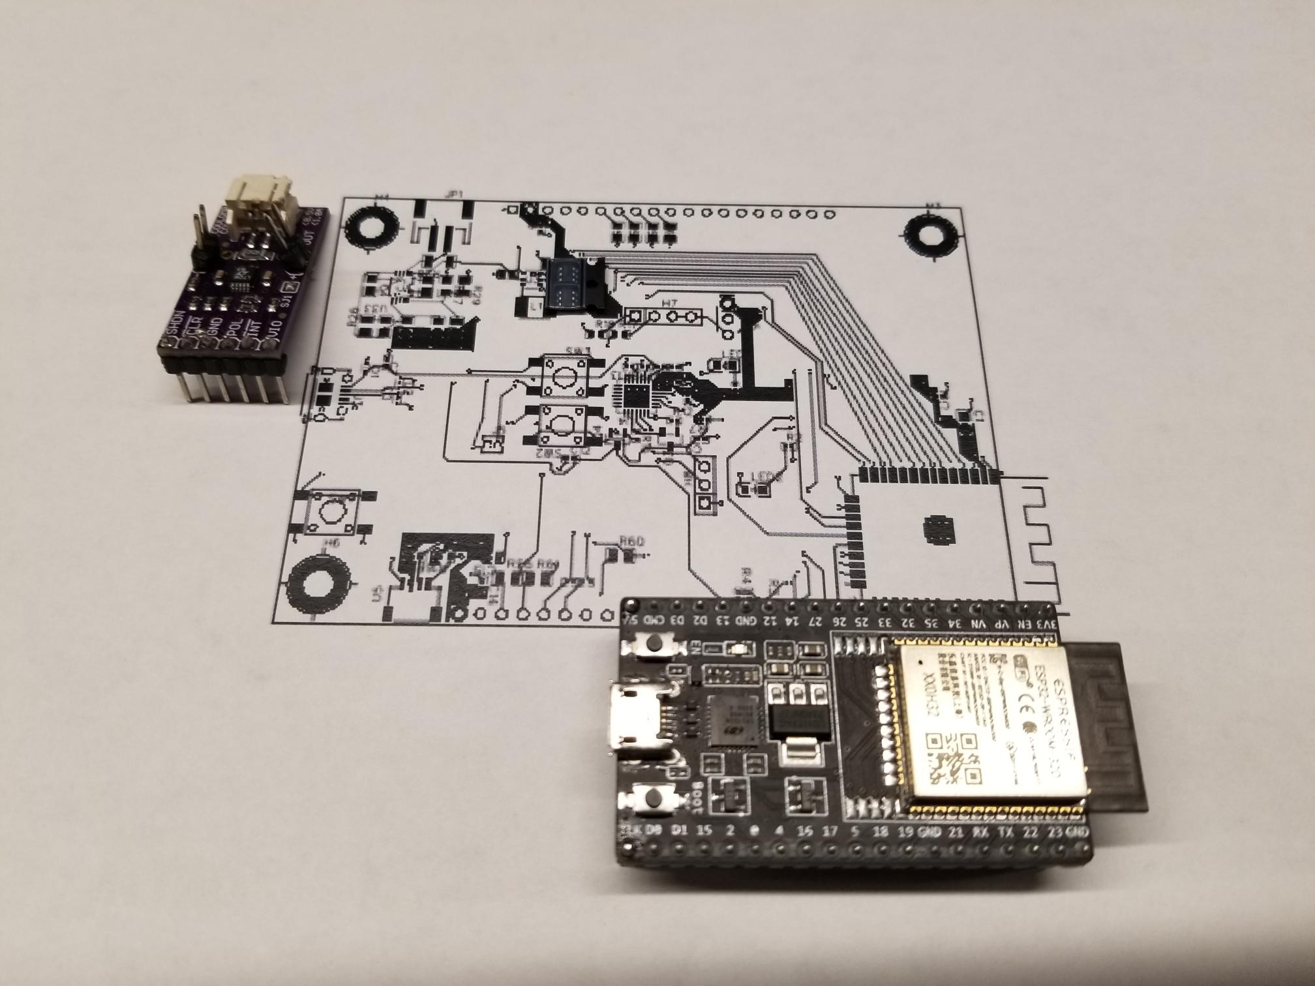
PCB layout

Slide 32
PROTOTYPING PROGRESS
Status Update
AMG8833 Thermal Sensor
ESP32 is able to read 8x8 array of °C values via I2C
Would need to set temperature threshold for person detection
Testing completed
Force Sensitive Resistor
ESP32 is able to read pressure value via ADC
Would need to set pressure threshold for sitting detection
Testing completed
LTC4150 Coulomb Counter
ESP32 is able to receive Interrupt every time 0.1707 mAh passes through the counter
Would need to do conversions/calculations, subtract mAh from current mAh.
Testing completed
LTC3531 3.3v Buck-Boost
Followed manufacturer’s recommendations in PCB design
Not Tested

Slide 33
SOFTWARE DEVELOPMENT STATUS
Status Update
Micro firmware
In Development
Able to read values for AMG8833 (I2C), FSR (ADC), CC (INT)
Able to send/receive data to Bluetooth-enabled device
Todo:
Process sensor data: normalization, averaging, etc.
Set internal thresholds for occupancy detection
Poll sensors through RTOS tasks controlled by timers
BLE communication protocol
Power optimization, i.e. putting micro to sleep
Server Software
In Development
Able to send/receive data from ESP32
Todo:
BLE communication protocol (multiple connections?)
Occupancy calculation / statistics
Phone App
Not Yet Started
Todo:
Connect to server to fetch occupancy status of seats (Backend)
Visually display occupancy status (UI)

Slide 34
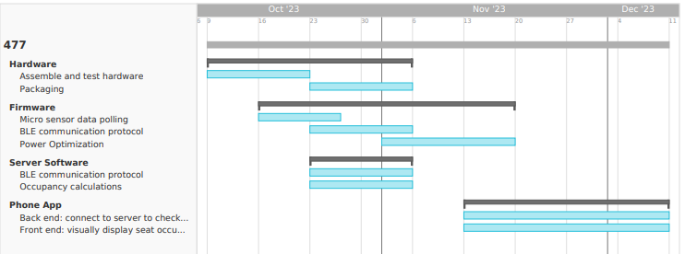
PROJECT TIMELINE
GANTT CHART

Slide 35
3D PRINTING
Questions?

